Slide 1

Learning Target: Students will be able to read, write and talk about the history and obstacles faced by someone who migrated to the United States.
Estudiantes pueden leer, escribir y conversar sobre la historia y obstáculos en la vida de alguien que emigró a los Estados Unidos.
(3 min)

Slide 2


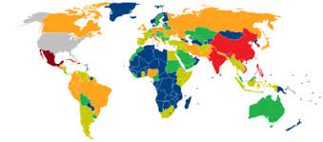

Do you remember what we learned about the push and pull factors of migration/migracion?
(3 min)

Slide 3
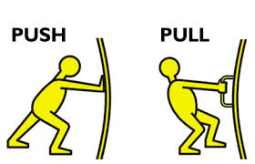



Immigrants migrate because of push and pull factors/reasons:
Push Factor (-) Pull Factors (+)
not enough work, money better work opportunities, more money
Insuficiente trabajo/economia Mas trabajos/oportunidades/dinero
wars, conflicts, abuse more freedom, more rights
guerras, conflictos, abusos mas libertades, mas derechos
inadequate housing more housing
Insuficiente vivienda mas vivienda
(5-8 min)

Slide 4



Immigrants also face obstacles (obstaculos) when they migrate. Many times, these are push factors but there is more to consider…
Obstacles = challenges, difficulties, problems.
Obstáculos= desafios, dificultades, problemas
“I think an obstacle people face when migrating to a new place is….”
“Yo creo que un obstaculo que tienen personas cuando migran es…”
(Turn and Talk: 5 Novel/New Ideas)
Class Share: (actual learner responses)
1. Miss family left behind 4. family breakup
2. Discrimination 5. not fitting in
3. lack of education 6. English fluency
(10 MIN)

Slide 5

Reading for Specific Information
Before we continue, let’s review image response, and skimming and scanning our readings to find the information we need.

Slide 6
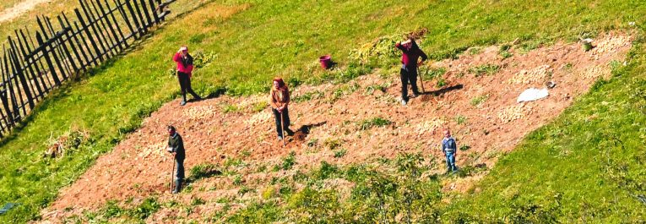

Image Response: Who and what do you see in the picture? What is happening in the image? How do you think the picture relates to the reading?
Example:
I see a field and people. They can be either friends (amigos), coworkers (compañeros de trabajo) or family (familia)…
Your turn (use gestures):
What are they doing in the picture?
Qué hacen en la foto?
(3-5 min)

Slide 7
For the readings, we will skim and scan for some text features and information. This means we will read quickly to get an idea and find some information in the reading.
Handout #2.2: “I am from Jamaica” TITLE (AUTHOR USUALLY FOLLOWS THE TITLE BUT CAN BE FOUND IN OTHER PLACES/ABOUT)
My name is Imogene Hayes, and I am from Kingston, Jamaica. I am the oldest child in my family, so I had many responsibilities at home. I worked in a post office in Jamaica, and I also took care of my little brothers and sisters and helped my mother with the cooking and cleaning. I made very little money (WHY), even though I worked very hard. I learned about an agency in New York that helped young women find jobs as maids in private family homes. I applied for a job as a maid, and I also applied for a visa to immigrate to the United States. When I received my visa, I moved to New York, where I got a job with a family (WHY), working in their house. I took care of their two children and I also cooked and cleaned. It was still hard work, but I was paid well (WHY), and I was proud to be living in New York on my own.
— Imogene Hayes (AUTHOR/WHO), immigrated from Jamaica, 1969 (YEAR OF IMMIGRATION/WHEN)
Who is the author/writer? The author is_____________________.
When did the author immigrate to the United States? The author immigrated to the U.S. in _______________.
Why did the author immigrate to the U.S.? The author immigrated to the U.S. because ____________________________.
Look for keywords and pay attention to text features for context:
WHO/QUIEN = names after title OR at the end of the text, like at the end of a letter:
WHEN/CUANDO= look for dates, months, years (#)
WHY/PORQUE= start by looking for push or pull factors/reasons why people migrate as previously discussed- keywords: work, job, money, home, wars, family etc. You can also add obstacles individuals face when they immigrate if noted in the reading: family breakups, discrimination, lack of English fluency etc.
(10 min)

Slide 8


Reading with a Purpose
YOUR TURN (Expert Group Assignments)
Group A: I am from Mexico
Group B: I am from Vietnam
Group C: I am from Sudan
Group D: I am from Honduras (10-15 MINUTES)
Exit Slip in Your Journals Complete questions 3 and 4:
3.) One question I would like to ask the author is….
Una pregunta al autor es..
4.) One connection I can make to the image is…
Una coneccion al imagen es…
( (6 MINUTES)
Round Robin Reading

